Slide 1
How to build an Industry Cost Profile (ICP) for a product in India
Identify Data Sources for Financial and Manufacturing Information Related to Industry Code
Step 2
Select the Industry Code Based on the Supplier’s Business and Product
Step 3
Use Financial and Manufacturing Information to Calculate Ratios for DM, DL, MOH, COGS, PBT, GSA & Other Expenses
Step 1

Slide 2
Identify Data Sources for Financial and Manufacturing Information Related to Industry Code
Step 1
India Government economic statistics are found at:
This data source will provide all the data required to build the cost profile
 | Direct Material (DM)
 | Direct Labor (DL)
 | Manufacturing Overhead (MOH)
 | Cost of Goods Sold (COGS)
 | GSA & Other Expenses
 | Profit Before Tax (PBT)
 | Total Sales
http://microdata.gov.in/nada43/index.php/home
Manufacturing data
Source: India Government economic statistics
Financial data
Source: India Government economic statistics
*You will use the data sources to express DM, DL, MOH, COGS, GSA & Other Expenses and PBT as ratios, in the form of percentages of Total Sales.
Note: Use financial reports of companies (Income Statement or Profit/Loss Account) as an additional source of Financial data

Slide 3
Select the Industry Code Based on the Supplier’s Business and Product
Step 2
1. Go to
2. Click on “Microdata Catalog”
3. Search for “Annual Survey of Industries”
http://microdata.gov.in/nada43/index.php/home

Slide 4
Select the Industry Code Based on the Supplier’s Business and Product
Step 2
4. Click on “Datasets”
5. Search for the latest “Annual Survey of Industries” – in this case 2017-18

Slide 5
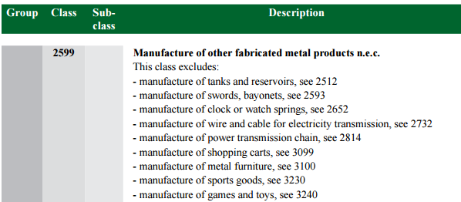
Select the Industry Code Based on the Supplier’s Business and Product
Step 2
6. Scroll down and click on “Nic_2008” to open the PDF file
7. In the PDF file, Use Control + F to search for keywords to locate the industry of interest and record the 4 digit respective NIC code for the industry of interest.
(e.g- NIC code- 2599 – “Manufacture of other fabricated metal products n.e.c”)

Slide 6
Use Financial and Manufacturing Information to Calculate Ratios
Step 3
In India, follow 9 steps to find DM, DL,MOH,COGS, GSA & PBT. Steps: 1–3
1. On the same webpage, scroll up and look for “Annual Survey of Industries 2017-18 Volume – I”. Click on the pdf icon to access the latest publication of industry statistics

Slide 7
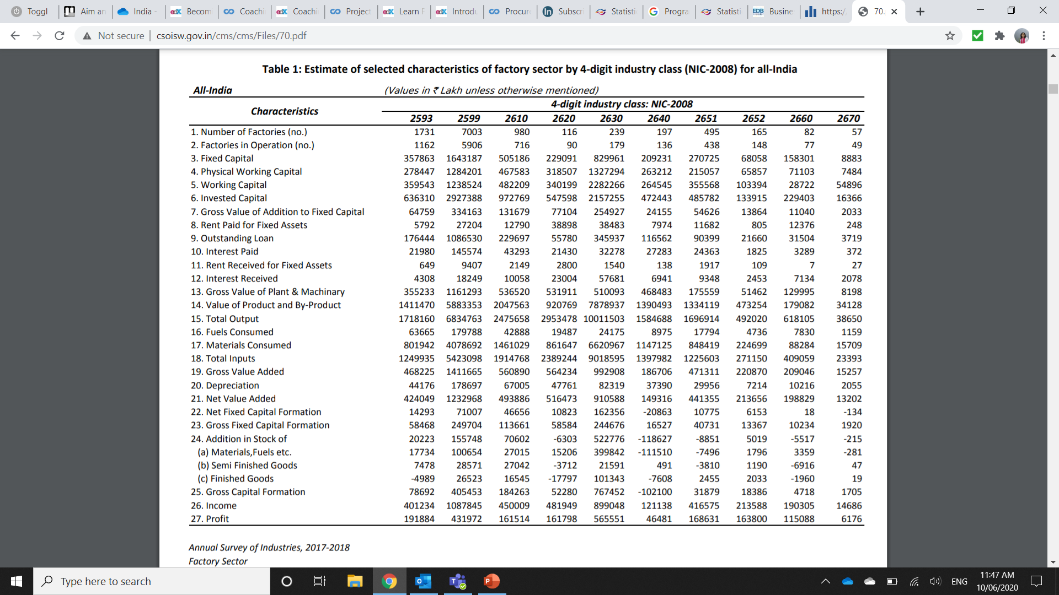
Use Financial and Manufacturing Information to Calculate Ratios
Step 3
2. In the PDF file, Scroll down to locate “Table 1: Estimate of selected characteristics of factory sector by 4-digit industry class (NIC – 2008) for all India”
Record the following values for NIC code 2599:
-15. Total Output
-17. Materials Consumed
-18. Total Inputs
-20. Depreciation
-27. Profit

Slide 8
Use Financial and Manufacturing Information to Calculate Ratios
Step 3
3. In the PDF file, Scroll down to locate “Table 3: Estimate of (i) employment, (ii) mandays employed and (iii) emoluments paid in the factory sector by their type
for each 4-digit industry class (NIC-2008) for all-India”
Record the following values for NIC code 2599:
-1.1.1. Workers (Wages to workers)

Slide 9
Use Financial and Manufacturing Information to Calculate Ratios
Step 3
Steps: 4 – 5
4. Calculate the DM ratio as percentage of Total sales
5. Calculate the DL ratio as percentage of Total sales
 | 17. Materials Consumed | 4078692
 | 15. Total Output (Total Sales) | 6834763
 | Direct Material (DM) | 59.68%
 | 1.1.1. Workers | 293181
 | 15. Total Output (Total Sales) | 6834763
 | Direct Labor (DL) | 4.29%
4.
5.

Slide 10
Use Financial and Manufacturing Information to Calculate Ratios
Step 3
Steps: 6
6. Calculate MOH by deduction as follows:
Calculate MOH ratio as a percentage of Total Sales
 | 18. Total Inputs | 5423098
 | plus 20. Depreciation | 178697
 | less 17. Materials Consumed | 4078692
 | Manufacturing Overhead (MOH) | 1523103
 | Manufacturing Overhead (MOH) | 1523103
 | 15. Total Output (Total Sales) | 6834763
 | Manufacturing Overhead (MOH) | 22.28%
6.
MOH = Total Inputs + Depreciation – Materials Consumed

Slide 11
Use Financial and Manufacturing Information to Calculate Ratios
Step 3
Steps: 7 - 8
7. Calculate COGS as follows:
8. Calculate PBT ratio as a percentage of Total Sales
 | Direct Material (DM) | 59.68%
 | Direct Labor (DL) | 4.29%
 | Manufacturing Overhead (MOH) | 22.28%
 | Cost Of Goods Sold (COGS) | 86.25%
 | 27. Profits | 431972
 | 15. Total Output (Total Sales) | 6834763
 | Profit Before Tax (PBT) | 6.32%
7.
COGS = DM+DL+MOH
8.

Slide 12
Use Financial and Manufacturing Information to Calculate Ratios
Step 3
Steps: 9
9. Calculate GSA & Other Expenses as follows:
 | Total | 100.00%
 | less COGS | 86.25%
 | less PBT | 6.32%
 | GSA & Other Expenses | 7.43%
9.
GSA & Other = 100-COGS-PBT

Slide 13
Present all your calculated ratios in the cost breakdown format
Industry cost profile for “Other Fabricated Metal Products”
 | Direct Material (DM) | 59.68%
 | Direct Labor (DL) | 4.29%
 | Manufacturing Overhead (MOH) | 22.28%
 | Cost of Goods Sold (COGS) | 86.25%
 | GSA & Other Expenses | 7.43%
 | Profit Before Tax (PBT) | 6.32%
 | Total Sales | 100.0%
Ratios calculated from India government economic statistics
Ratios calculated from India government economic statistics

Slide 14
References and summary of ICP calculations
Cost Element | % of Sales | Calculation | Order
DM | 59.68% | = B/A | 1
DL | 4.29% | = C / A | 2
MOH | 22.28% | = (D-B+E)/A | 3
COGS | 86.25% | = DM+DL+MOH | 4
GSA | 7.43% | = Total - COGS – PBT | 6
PBT | 6.32% | = F/A | 5
TOTAL | 100.0%
SUMMARY OF DATA
 | Data point | Value | Source
A | Total Output (Sales) | 6834763 | Annual Survey of Industries 2017-18 Volume – I NIC 2599
B | Materials Consumed | 4078692 | Annual Survey of Industries 2017-18 Volume – I NIC 2599
C | Wages to workers | 293181 | Annual Survey of Industries 2017-18 Volume – I NIC 2599
D | Total Inputs | 5423098 | Annual Survey of Industries 2017-18 Volume – I NIC 2599
E | Depreciation | 178697 | Annual Survey of Industries 2017-18 Volume – I NIC 2599
F | Profit (before tax) | 431972 | Annual Survey of Industries 2017-18 Volume – I NIC 2599

